Slide 1
Naming Convention
Next Generation Warehouse management system
Process ID
Char 1-4 | Char 5 | Char 6 | Char 7-10
Global customer code | Region(A) | Direction I: From customer to Schenker O: From Schenker to customer | free form
Mapping Name
A_MAP_<PID>_NGW_<INFORMAT>_TO_<OUTFORMAT>
Example:
PID: LAPRAOKRGM
Mapping Name: A_MAP_LAPRAOKRGM_NGW_SA_TO_FF
Shared Services Center | Global Integration & eServices

Slide 2
Detection and Routing
Direction I
Inbound Agreement: <PID>AIXXXX_inbound
Example: LAPRAIXXXX_inbound
Routing Code: NGW_<Country>_FTP, FileName→<REF#10>
Example: NGW_CN_FTP
Direction O
Inbound Agreement: <PID>AOXXXX_inbound
Example: FMCCAOXXXX_inbound
Shared Services Center | Global Integration & eServices

Slide 3
Structure and References
References
Sequence | Name
<REF#2> | Unique-ReferenceID
<REF#4> | EDIType
<REF#8> | CountryCode
<REF#9> | CustomerCode
Direction I
Output filename:
/<MessageType>/ApplicationArea/MessageID
<REF#8>_<REF#9>_<REF#4>_<REF#2>_Date/Time_Running#.XML
Attention:
Don’t put outgoing filename to structure OUT, because CR_FetchComm executes before CR_FetchRefOUT
Shared Services Center | Global Integration & eServices

Slide 4
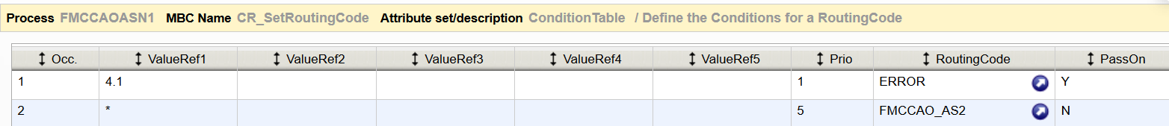
Structure and References
Direction O
Input filename:
/<MessageType>/ApplicationArea/MessageID
<REF#8>_<REF#9>_<REF#4>_<REF#2>_Date/Time_Running#.XML
Set a reference majorVersionNr after mapping(PostProc structure)
Use CR_SetRoutingCode
Setting like below
Shared Services Center | Global Integration & eServices

Slide 5
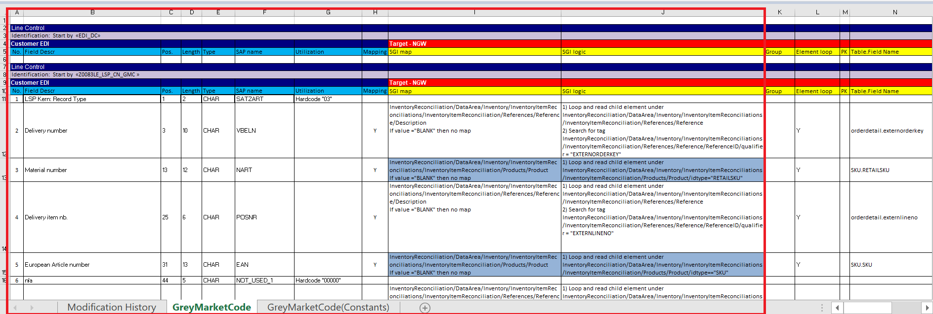

Mapping Spec
Normally mapping to Reference, is to Reference/Description
If it’s direction O, don’t need to pay attention to Constants sheet.
Shared Services Center | Global Integration & eServices

Slide 6
Mapping
XSD, ADFs can be found on teams: CBI - Sword Integration>NGW
Hardcode string "blank" to required fields that cannot be empty according to schema/xsd.
Always select the first value for the required Enumeration fields of the schema but not used in mapping.
Date like 0000-00-00 or 0 or Empty - should be mapped as 1900-01-01
Shared Services Center | Global Integration & eServices

Slide 7
Constants Values
Element | Value
majorVersionNr/minorVersionNr | “4.1”
Reference/type | "XRF:ALL"
Reference/ReferenceID/agencyID | "AG"
PartnerID/agencyID | "Schenker"
Shared Services Center | Global Integration & eServices

